Slide 1
Welcome to Nursery
2024-25 Cohort

Slide 2


Meet the team
Who will I be working with?

Slide 3

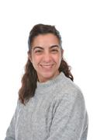
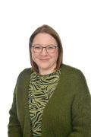
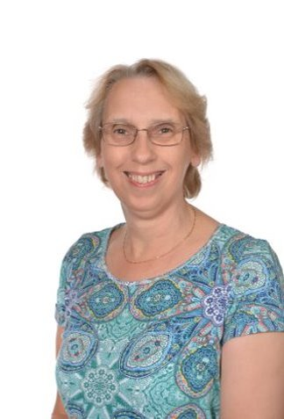
The Adults in Nursery
Mrs Burland Mrs Menevilli Mrs Gilbody Mrs Newland

Slide 4
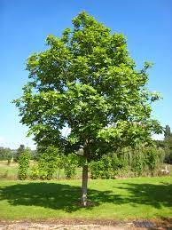
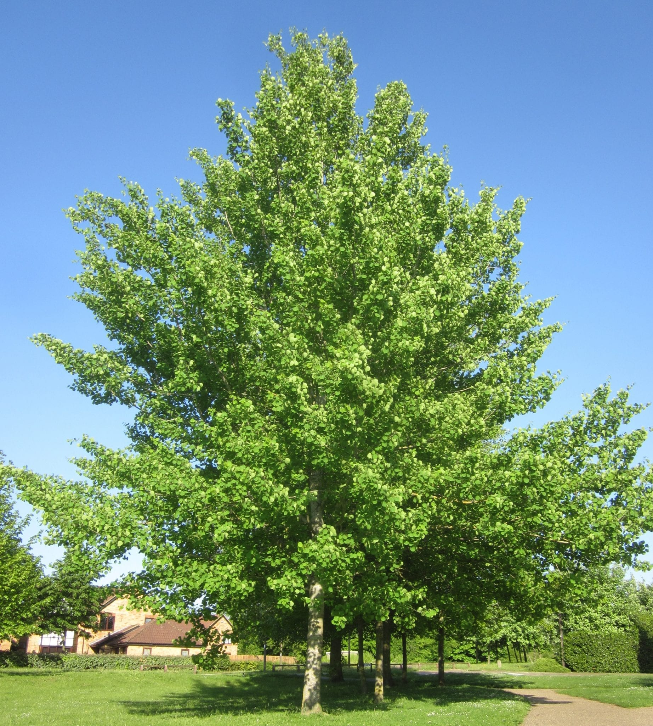
Classes
The nursery classes work together and free flow for the majority of the session. The children have the opportunity to interact with all adults across the settings. For registration and adult focused learning sessions they are split into 2 classes. These are called Ash and Aspen.
Ash is our 15-hour provision and Aspen in our 30-hour provision.

Slide 5
School Uniform
Round Neck Sweatshirt or Cardigan with Embroidered School Crest (Bottle Green)
White polo shirt/blouse
Grey trousers/knee length skirts
Shorts and summer dresses can be worn in warm weather.
Black shoes (with suitable heels) or trainers (with black shoelaces)
White, black, or grey socks or tights
For PE lessons
Black trainers or plimsolls
Swimming costume, towel, and swim hat.
The school has a uniform and children are expected to adhere to this. The children wear their uniform with pride and should be smart with shirts tucked into trousers or skirts.
School uniform is supplied by Create Identitee, it can be ordered directly with them at their shop Unit 43 Greenway Business Centre, Harlow, Essex, CM19 5QE, or over the telephone 01279 456016. Order forms and samples of sizes are available at the school office

Slide 6


Please name all of your child’s clothes and belongings
The following links take you to 2 companies that provide the PTA with a % of your purchases to help to raise money for the school.
Stamptastic - https://stamptastic.co.uk/#a_aid=5edcc47baf3eb
School Affiliate ID: 5edcc47baf3eb
School PTA Code: CM187BY
My Name Tags - https://www.mynametags.com/
School code - 6806

Slide 7
What will a day be like?
Let’s see how your day will start

Slide 8
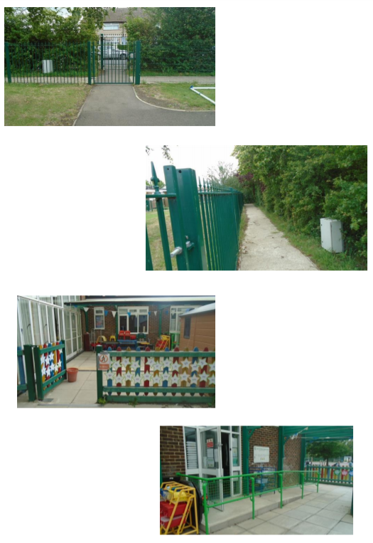
When I come into school:
You will come into the Nursery outdoor areas through the Trotters Road gate. You will put your water bottle/lunchbox on the trolley and book bag in the basket. You will play outside first for a while, then:
You will put your coat on your own peg (this will have your name on it).
You will place your name on the self-registration board.
Then it is time to get busy with your friends by exploring the activities in the classroom.

Slide 9
Things to bring
Every day:
Correct school uniform and hair tied up (if longer than shoulder length). Please name all uniform, even socks and shoes. We have 60 sets of identical uniform and we can help lost items get back to the right owner if things are clearly labelled. The uniform shop will embroider initials on for a small charge.
Water bottle to keep in the classroom (we encourage children to drink water only).
We ask that children do not bring toys into school. If they need a toy from home for comfort then this must be put in their book bag before coming into the classroom.
At snack time the children have a piece of fruit or vegetable (free of charge from the National Fruit for Schools scheme).
Children in Aspen need to bring their lunchbox every day.
Each week:
Any homework (when specified)
Children will have a book to share with adults at home. This will be changed weekly, on a set day.
Swimming kit and £3 contribution once a week - swimming will take place in the Summer term. The day will be confirmed nearer the time.
Book bag (labelled clearly) every Friday.
Plimsols for PE if the children would like to wear them

Slide 10
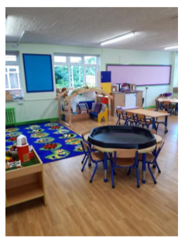
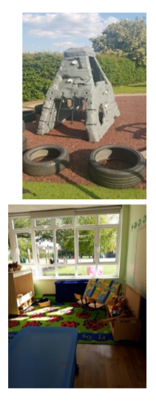

Your day:
Throughout the day you can explore the activities in both classrooms and in the Early Years garden. They are set up to support the topic and the 7 areas of the Early Years curriculum (information is available on our website about what the children are learning each term).
Sometimes you will choose how you learn and play with your friends; at other times you will complete activities with adults.

Slide 11
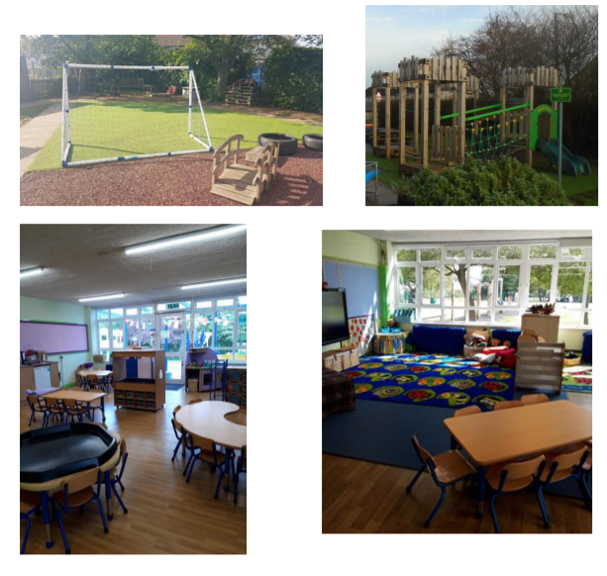
Your day:
Across each day there will be 2 whole class teaching sessions for Ash, and 3 for Aspen. This includes daily phonics and lots of other sessions linked to the Early Years areas. For most of these you will sit with your class on the carpet area.
Each day you will have snack. We have lots of different food to try, including a variety of fruit and vegetables and things like dips, biscuits, yoghurt and wraps. Sometimes you help to make your own snack. We always wash our hands before having food.

Slide 12
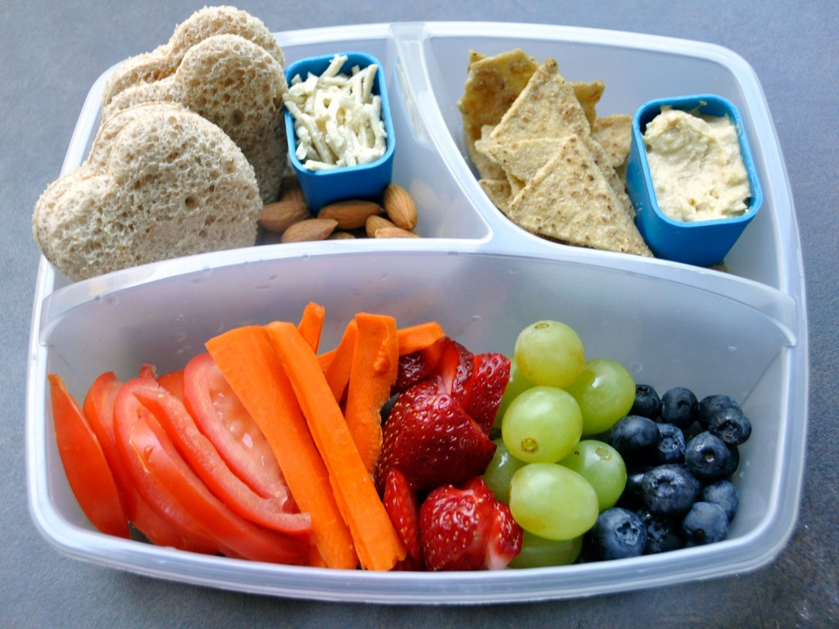
Lunchtime (Aspen)
Children in Aspen will need a packed lunch each day.
We are a NO NUT school.
Packed lunches should contain a healthy balance of food, children must not have chocolate bars, sweets or fizzy drinks.

Slide 13
Learning opportunities:
In our Early Years we value learning through play and exploration. We aim to plan these opportunities in our indoor and outdoor environment. Here are some of the fantastic opportunities that pupils at Pear Tree Mead Academy can enjoy:
A variety of activities and areas with provision for children to access, across both nursery classrooms and the Early Years Garden.
Forest School
Outdoor learning in different areas of the school; our pond and woodland area.
Swimming. Children will need a costume, swim hat and towel. Swimming costs £2 a week.
A challenging and enabling learning environment.
If you would like to find out more about the Early Years Foundation Stage then visit this website: https://www.foundationyears.org.uk/. You can also find out more about our Early Years by visiting the school website: http://www.peartreemead.essex.sch.uk/school-life/curriculum/.

Slide 14
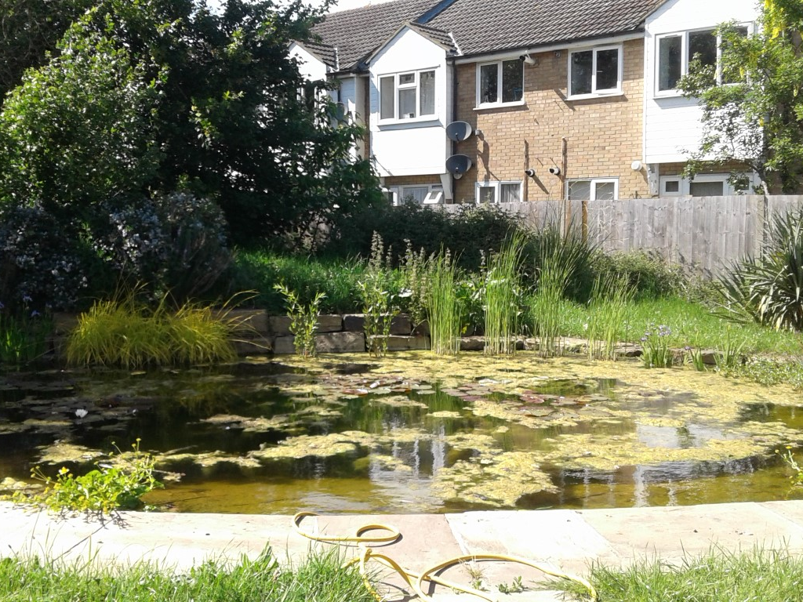
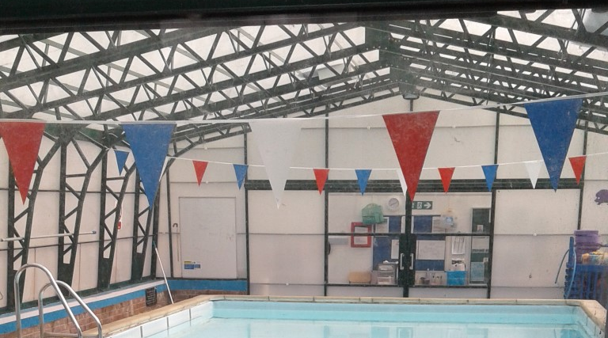
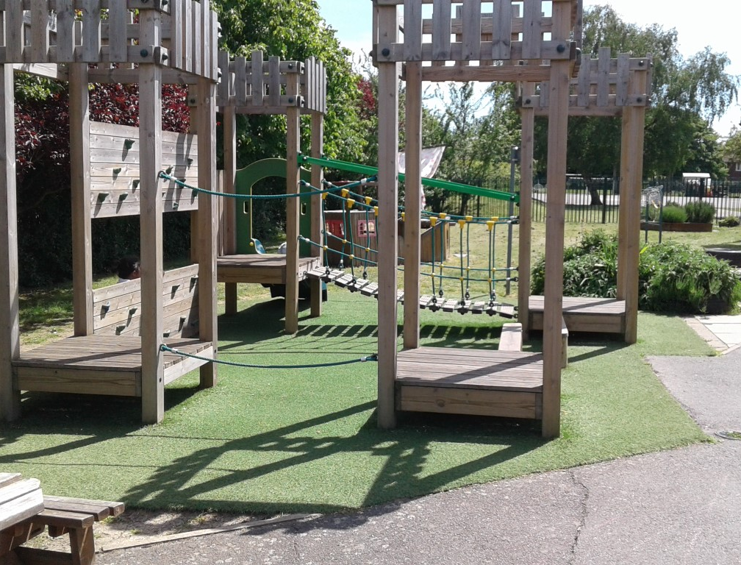

Slide 15

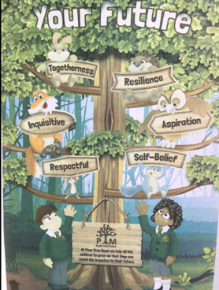
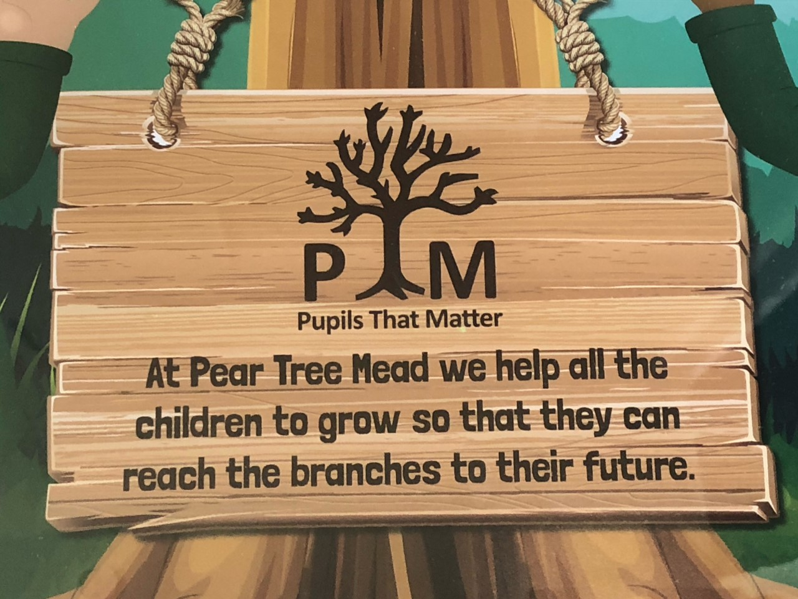
Pear Tree Mead Academy – school vision and motto.

Slide 16



School Branches:
In the Early Years we focus on the first three branches:

Slide 17
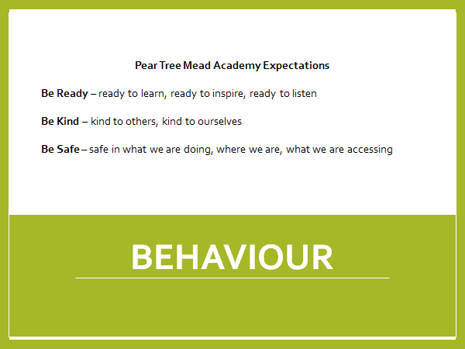
Behaviour:

Slide 18
Other Recognitions
Children can receive a Headteachers Award for excellent work and effort in their learning.
We also have a ‘Thank You’ box in the main office where staff, parents and children can write messages of thanks to all school groups. These are shared in Assembly. This supports well-being within the school across all stakeholders.
Children are rewarded in several ways. Staff give out stickers, certificates and lots of praise.

Slide 19
What if you are not doing the right thing
Appropriate consequences will be given, taking into consideration the child
We will communicate behaviour and consequences with the child’s parents where necessary, and only that of their child, not any other pupils' involvement
In extreme instances, where behaviour is continuous, over time, or for one large incident, the pupil may face expulsion for a fixed period (this will be communicated with parents and formally by letter). Incident(s) can include the pupil putting themselves or others at risk, safety of them or others and/or verbal/physical harm.

Slide 20

Attendance at PTM
Will your child be a PTM Attendance Hero next year ?
Being here every day and on time really helps your child be happy, successful and get the very best from their education.

Slide 21

Did you know…
That just being late regularly can soon build up many hours of lost learning.

Slide 22
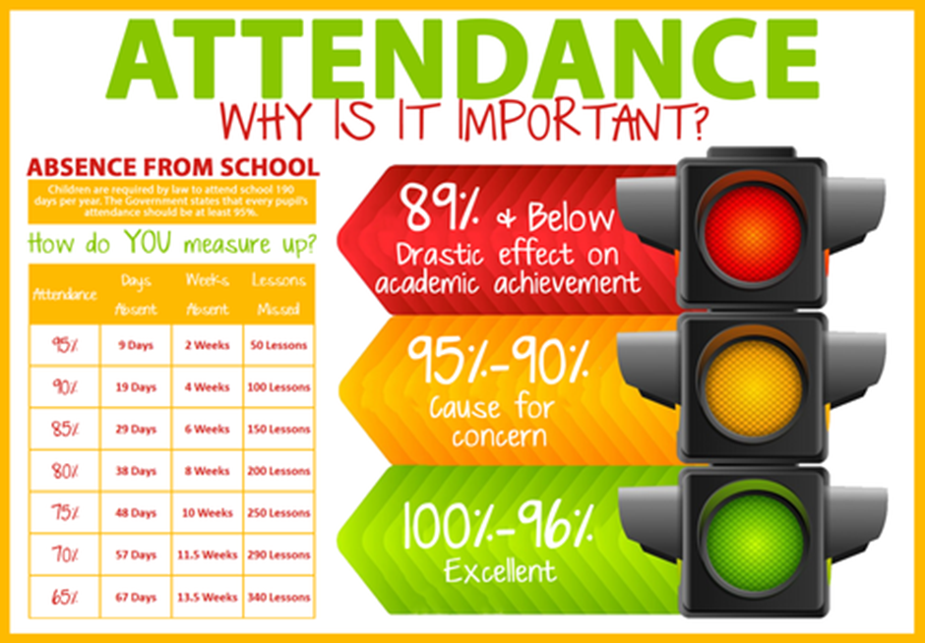
Regular attendance is so important as just 2 weeks off school in a year will mean you child misses 50 lessons .
For more information on the school’s policy regarding attendance please visit
Attendance - Pear Tree Mead Academy

Slide 23
Useful websites:
These are some useful websites for you to use across the year :
Busy Things www.busythings.co.uk This is a fun educational website which has activities for a variety of early learning areas. Username-home5826 Password-peartree
Letter join website for handwriting letter practise https://www.letterjoin.co.uk/log-in.html
Topmarks website for EY games www.topmarks.co.uk

Slide 24

Sharing your child’s learning:
Your child will choose a sharing book in school. They will take this home; this is a story book that you can enjoy reading together.
We may set challenges on Tapestry for you to complete.
We ask for any of the learning above to be recorded on Tapestry.

Slide 25
Who to talk to:
If you have anything that you would like to talk about then the first point of call is always the Nursery Leader, Deputy or any of the learning support assistants. We are very happy to talk. We don’t check book bags daily, so please hand any letters to the staff member at the door.
If you would like to talk at the end of the nursery day please wait until children are safely let out of the classrooms first.
If you feel that after speaking to a member of the class staff you still need to speak to someone else then please contact the school office as they will be able to point you in the right direction of who is best to speak to.

Slide 26

“Helping the school to create memorable experiences for all Pear Tree Mead pupils”
Registered Charity: 1040711

Slide 27
What is ‘Friends of Pear Tree Mead’ (FOPTM)?
A registered charity whose aim is to fundraise on behalf of the school to provide additional resources and equipment
A community of volunteers who help out at events hosted by FOPTM. We have our own facebook page where you can find out what's going on.
A way to meet other parents and make new friends whilst supporting the school.
A separate entity to the school – If the school want FOPTM to fund something they have to request it in writing and it is put to a vote at our termly FOPTM meeting. Equally, if we want to run an event at the school, their staff are given the option to assist on a voluntary basis

Slide 28



How do we fundraise?
We run a variety of events throughout the year with the aim to ensure that whilst profitable, our events are affordable to all families.
Some of our events are for pupils only, but we also run family events after school, in the evenings and at weekends
We run present sales at Christmas, Mothers Day and Fathers Day to enable children to choose a pre-wrapped gift
At all school productions we sell to order from a selection of production photos taken during the class dress rehearsals.
We also raise funds by using Amazon Smile, Bag2School and asking organisations to match funds on stalls at larger events like our Summer fete and Christmas Bazaar.
We have a small team of parent volunteers who work tirelessly to manage the collection and sale of pre-loved uniform

Slide 29
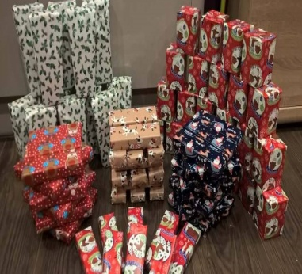
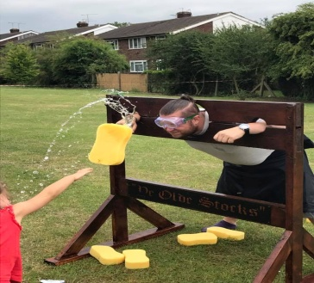
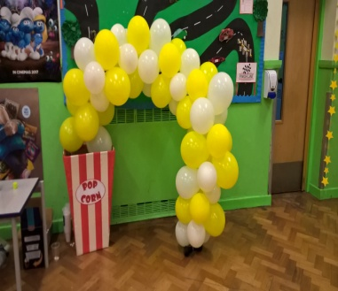
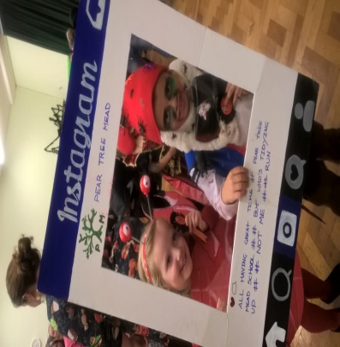
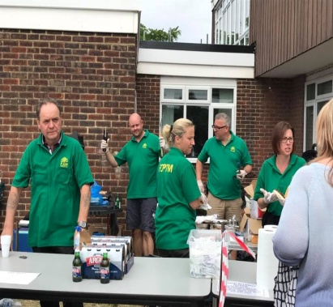
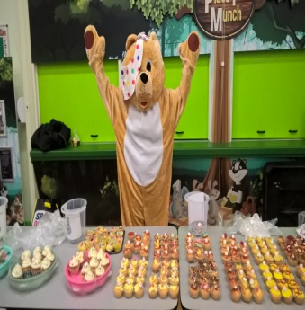
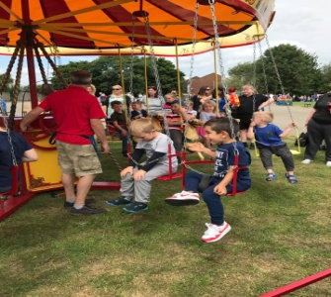
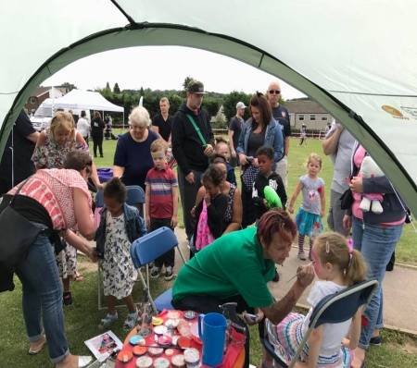
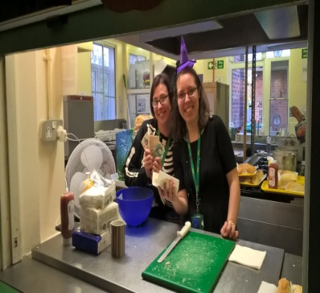
How do we fundraise?
Some of the events we have organised recently include:
Halloween Disco
Christmas Bazaar
Summer Fete
Summer Splash
Break the Rules Day
Pop Up Circus
After School Film Club
Family Race Night
Singo Bingo
After School Cake Sale
Present Sales

Slide 30
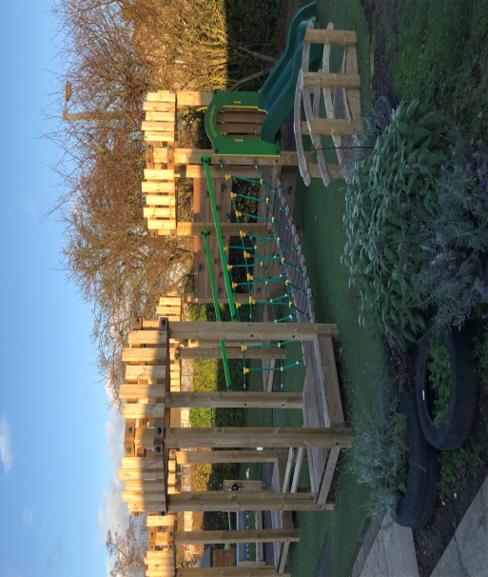
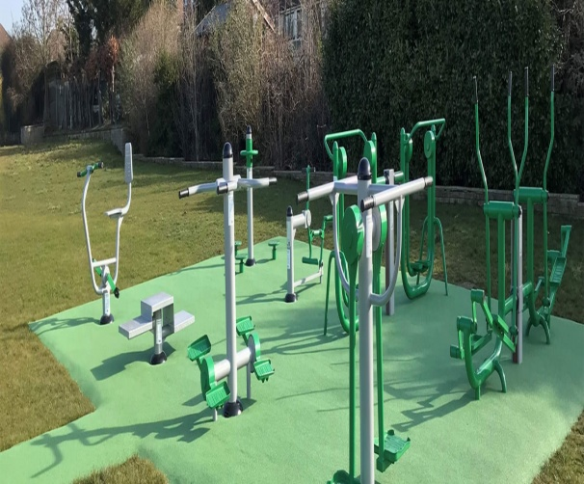
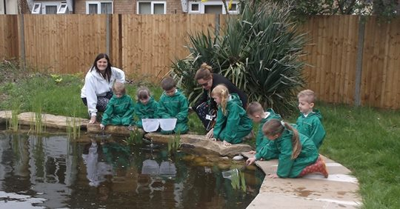
What have we funded?
Our main fundraising project at the moment is for the OPAL project, but in recent years we have also funded...
Provision of outdoor gym equipment
Clearing and landscaping the pond as an outdoor learning area
Replacing climbing frames in all playgrounds
Plus... New curtains for the main hall, outdoor educational posters, a defibrillator and repairs to pool facility!

Slide 31


How can you help?
Every event we run requires manpower to source materials, set up, and host the event on the day. Without parents who are willing to give up their time, we simply would not be able to run things like school disco’s, film clubs, fetes and bazaars – All the things we know the children love!
We are desperately short of volunteers, with quite a few of our ‘regular’ parent helpers moving on to secondary school this year.
If you would like to get involved, please come along to a meeting to see what you can do to help – You can give up as much or as little time as you are able and there are always a variety of tasks to suit everyone's individual commitments and skills. Our meeting dates are published via parent mail and our facebook page, which will also keep you up to date with upcoming events where help us needed.

Slide 32
Can you help us?

Slide 33
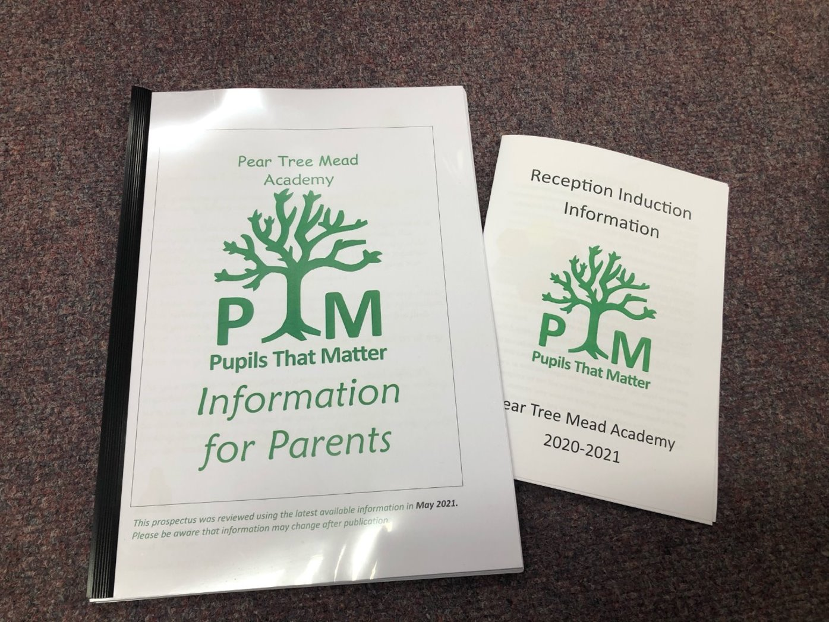
For more information
Please read the information that we have sent you and check out our school website
www.peartreemead.essex.sch.uk

Slide 34
Transition Visits
These PowerPoints will be on the school website for you as soon as possible.

